Slide 1

By Angie Brooks
EWO

Slide 2




Who makes the rules?
Help them bee a100%!
Notes:
We don’t make the rules! The Government does! But we have to follow the rules!

Slide 3

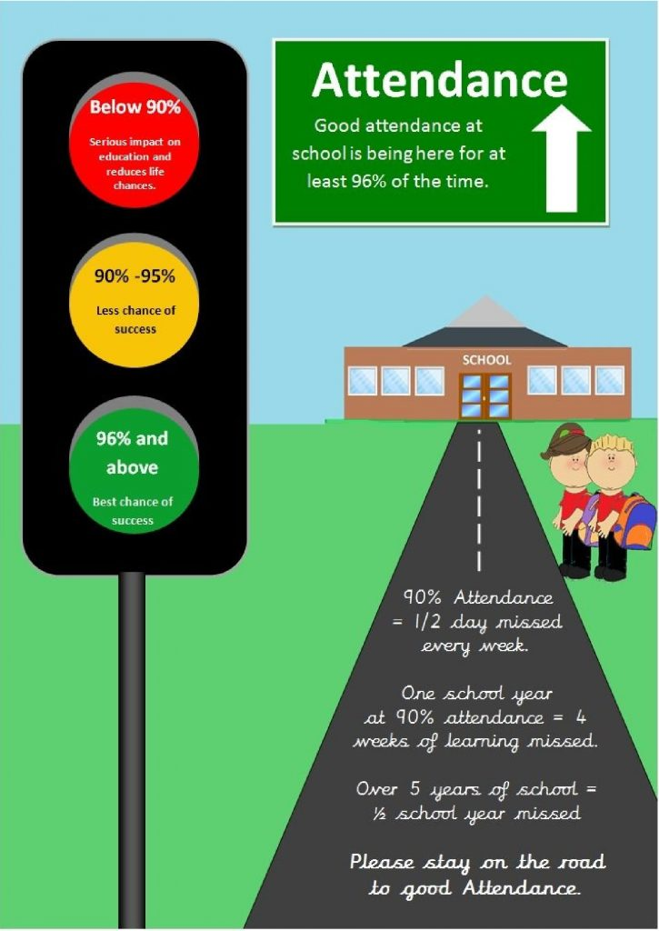




Where will they fit in the traffic light system?
Red – Less chance of success
Orange – Better chance of success
Green – Best chance of success
You make the difference!
Notes:
90% attendance – ½ a day missed every week. 90% attendance for the year = 4 weeks absence on top of the 12 weeks school holidays you already have off! Over 5 years, that is ½ a year missed learning!

Slide 4

HERE
EVERYDAY
READY
ON TIME
HERO!
Notes:
Think about the bigger picture. Have a goal or dream of where or what you want to do in life.

Slide 5

Remember!
Notes:
So being on time really does make a difference!

Slide 6


Slide 7
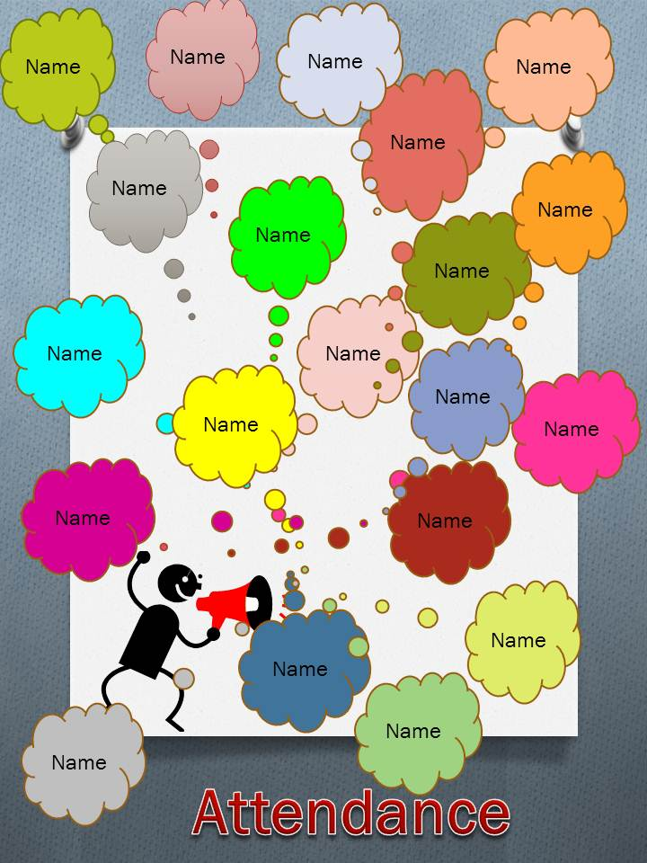
Be there for their name to be called out!
Don’t let anyone miss them!
Let them keep their friends by being reliable!
Help them learn everyday!
Let them build on their knowledge! No gaps!
No walk of shame!
Keep
their
attendance
above
95%
Notes:
Don’t be anonymous!

Slide 8

96% or above!
ATTEND EVERY DAY POSSIBLE!
Remember, everyone gets sick or unwell. Just help them come back to school as soon as they feel better!
Make sure you get them to school on time! So they don’t miss anything important!
Get their things ready for school the night before!
Tell a teacher or class help if they are upset or they are struggling with something. Don’t let them have time off for it! It just gets bigger!
Remember why they are at school! Learn, play, wellbeing, rules, behaviour, routines, exercise.
Here, Everyday, Ready. On time!
Help them be a HERO!
Notes:
Every day matters!

